Slide 1
第8章 两个简单应用
cxiao@fudan.edu.cn

Slide 2
提纲
WebSocket应用
邮件发送程序

Slide 3
WebSocket应用

Slide 4
服务端依赖项
1 <dependencies>
2 <dependency>
3 <groupId>org.springframework.boot</groupId>
4 <artifactId>spring-boot-starter-web</artifactId>
5 <version>2.3.3.RELEASE</version>
6 </dependency>
7 <dependency>
8 <groupId>org.springframework.boot</groupId>
9 <artifactId>spring-boot-starter-websocket</artifactId>
10 <version>2.3.3.RELEASE</version>
11 </dependency>
12 </dependencies>

Slide 5
1 @Component
2 public class EchoHandler extends TextWebSocketHandler {
3 public static final ConcurrentLinkedQueue<WebSocketSession> clients = new ConcurrentLinkedQueue<WebSocketSession>();
4 private static final DateTimeFormatter sf = DateTimeFormatter.ofPattern("yyyy-MM-dd HH:mm:ss");
5 @Override
6 public void afterConnectionEstablished(WebSocketSession session) throws Exception {
7 // 产生随机名称，只发送给当前连接者
8 String randName = getRandomString(8);
9 session.sendMessage(new TextMessage(randName + " 建立连接！"));
10 // 保存名称，以便群发时使用
11 Map<String, Object> map = session.getAttributes();
12 map.put("name", randName);
13 // 添加至连接者列表
14 clients.add(session);
15 }
16 @Override
17 protected void handleTextMessage(WebSocketSession session, TextMessage message) throws Exception {
18 // 当服务端接收到任一连接者提交的消息时
19 var msg = message.getPayload();
20 // 稍作加工，转发给全部的连接者。转发信息包含提交者的随机名称
21 for (WebSocketSession client:clients){
22 String strMsg = LocalDateTime.now().format(sf) ;
23 client.sendMessage(new TextMessage(strMsg));
24 strMsg = session.getAttributes().get("name") + " : " + msg;
25 client.sendMessage(new TextMessage(strMsg));
26 }
27 }
28 @Override
29 public void afterConnectionClosed(WebSocketSession session, CloseStatus status) throws Exception {
30 super.afterConnectionClosed(session, status);
31 clients.remove(session);
32 }

Slide 6
33 //生成指定length的随机字符串（A-Z，a-z，0-9）
34 public static String getRandomString(int length) {
35 String str = "abcdefghijklmnopqrstuvwxyzABCDEFGHIJKLMNOPQRSTUVWXYZ0123456789";
36 Random random = new Random();
37 StringBuffer sb = new StringBuffer();
38 for (int i = 0; i < length; i++) {
39 int number = random.nextInt(str.length());
40 sb.append(str.charAt(number));
41 }
42 return sb.toString();
43 }
44 }

Slide 7
服务启动类
1 @SpringBootApplication
2 @EnableWebSocket
3 public class MyApplication implements WebSocketConfigurer {
4 //启动后，在浏览器输入 http://localhost:8080
5 public static void main(String[ ] args) {
6 SpringApplication.run(MyApplication.class, args);
7 }
8 @Autowired
9 EchoHandler echoHandler;
10 @Override
11 public void registerWebSocketHandlers(WebSocketHandlerRegistry webSocketHandlerRegistry) {
12 webSocketHandlerRegistry.addHandler(echoHandler, "/echo");
13 }
14 }

Slide 8
resources/static/app.js
21 function disconnect() {
22 if (ws != null) {
23 ws.close();
24 ws = null;
25 }
26 setConnected(false);
27 }
28 function echo() {
29 if (ws != null) {
30 var message = document.getElementById('message').value;
31 log('发送: ' + message);
32 ws.send(message);
33 } else {
34 alert('尚未建立连接，请单击“连接”按钮建立连接！');
35 }
36 }
37 function log(message) {
38 var console = document.getElementById('logging');
39 var p = document.createElement('p');
40 p.appendChild(document.createTextNode(message));
41 console.appendChild(p);
42 while (console.childNodes.length > 12) {
43 console.removeChild(console.firstChild);
44 }
45 console.scrollTop = console.scrollHeight;
46 }
1 var ws = null;
2 var url = "ws://localhost:8080/echo";
3 function setConnected(connected) {
4 document.getElementById('connect').disabled = connected;
5 document.getElementById('disconnect').disabled = !connected;
6 document.getElementById('echo').disabled = !connected;
7 }
8 function connect() {
9 ws = new WebSocket(url);
10 ws.onopen = function () {
11 setConnected(true);
12 };
13 ws.onmessage = function (event) {
14 log(event.data);
15 };
16 ws.onclose = function (event) {
17 setConnected(false);
18 log('提示: 关闭连接.');
19 };
20 }

Slide 9
1 <!DOCTYPE html>
2 <html>
3 <head>
4 <meta http-equiv="Content-Type" content="text/html; charset=utf-8" />
5 <link type="text/css" rel="stylesheet" href="https://cdnjs.cloudflare.com/ajax/libs/semantic-ui/2.2.10/semantic.min.css" />
6 <script type="text/javascript" src="app.js"></script>
7 </head>
8 <body>
9 <div>
10 <div id="connect-container" class="ui centered grid">
11 <div class="row">
12 <button id="connect" onclick="connect();" class="ui green button ">连接</button>
13 <button id="disconnect" disabled="disabled" onclick="disconnect();" class="ui red button">断开连接</button>
14 </div>
15 <div class="row">
16 <textarea id="message" style="width: 350px" class="ui input" placeholder="要发送的消息"></textarea>
17 </div>
18 <div class="row">
19 <button id="echo" onclick="echo();" disabled="disabled" class="ui button">发送消息</button>
20 </div>
21 </div>
22 <div id="console-container">
23 <h3>Logging</h3>
24 <div id="logging"></div>
25 </div>
26 </div>
27 </body>
28 </html>
resources/static/index.html

Slide 10
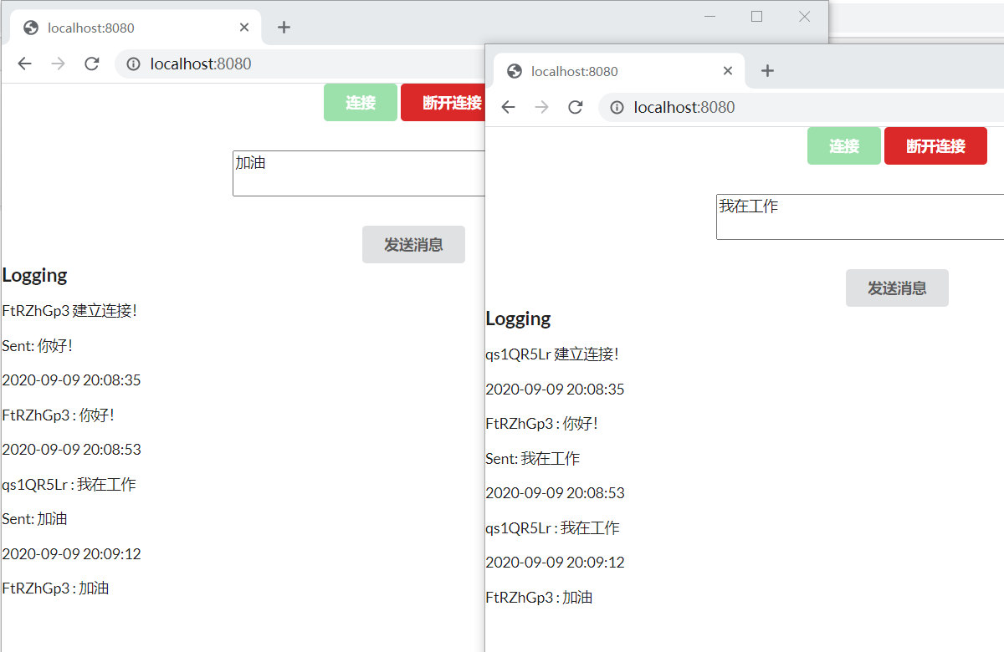

Slide 11
邮件发送程序

Slide 12
依赖项
1 <dependencies>
2 <dependency>
3 <groupId>com.sun.mail</groupId>
4 <artifactId>javax.mail</artifactId>
5 <version>1.6.2</version>
6 </dependency>
7 <dependency>
8 <groupId>org.projectlombok</groupId>
9 <artifactId>lombok</artifactId>
10 <version>1.18.10</version>
11 </dependency>
12 </dependencies>

Slide 13
存放邮件基本信息
1 @Data
2 public class SimpleMail {
3 private String[ ] to;
4 private String[ ] cc;
5 private String[ ] bcc;
6 private String from;
7 private String host;
8 private String port;
9 private String subject;
10 private String body;
11 private String[ ] attachment;
12 private String username;
13 private String password;
14 private Boolean isHtml;
15 }

Slide 14
1 public class MailUtils {
2 public static void sendMail(SimpleMail simpleMail) {
3 Properties properties = System.getProperties();
4 properties.setProperty("mail.smtp.host", simpleMail.getHost());
5 properties.setProperty("mail.smtp.port", simpleMail.getPort());
6 properties.put("mail.smtp.auth", "true");
7 try {
8 Session session = Session.getDefaultInstance(properties, new Authenticator() {
9 @Override
10 protected PasswordAuthentication getPasswordAuthentication() {
11 return new PasswordAuthentication(simpleMail.getUsername(), simpleMail.getPassword());
12 }
13 });
14 MimeMessage message = new MimeMessage(session);
15 message.setFrom(new InternetAddress(simpleMail.getFrom()));
16 List<InternetAddress> toList = new ArrayList<>();
17 List<InternetAddress> ccList = new ArrayList<>();
18 List<InternetAddress> bccList = new ArrayList<>();
19 if (simpleMail.getTo() != null) {
20 for (String str : simpleMail.getTo()) {
21 toList.add(new InternetAddress(str));
22 }
23 message.addRecipients(Message.RecipientType.TO, toList.toArray(new InternetAddress[ ]{ }));
24 }
25 if (simpleMail.getCc() != null) {
26 for (String str : simpleMail.getCc()) {
27 ccList.add(new InternetAddress(str));
28 }
29 message.addRecipients(Message.RecipientType.CC, ccList.toArray(new InternetAddress[ ]{ }));
30 }
31 if (simpleMail.getBcc() != null) {
32 for (String str : simpleMail.getBcc()) {
33 bccList.add(new InternetAddress(str));
34 }
35 message.addRecipients(Message.RecipientType.BCC, bccList.toArray(new InternetAddress[ ]{ }));
36 }
邮件发送功能

Slide 15
37 message.setSubject(simpleMail.getSubject());
38 BodyPart messageBodyPart = new MimeBodyPart();
39 Multipart multipart = new MimeMultipart();
40 if (simpleMail.getIsHtml()) {
41 messageBodyPart.setContent(simpleMail.getBody(), "text/html;charset=utf-8");
42 } else {
43 messageBodyPart.setContent(simpleMail.getBody(), "text/plain;charset=utf-8");
44 }
45 multipart.addBodyPart(messageBodyPart);
46 if (simpleMail.getAttachment() != null) {
47 for (String str : simpleMail.getAttachment()) {
48 messageBodyPart = new MimeBodyPart();
49 DataSource source = new FileDataSource(str);
50 messageBodyPart.setDataHandler(new DataHandler(source));
51 messageBodyPart.setFileName(MimeUtility.encodeText(str.substring(str.lastIndexOf("\\") + 1)));
52 multipart.addBodyPart(messageBodyPart);
53 }
54 }
55 message.setContent(multipart);
56 Transport.send(message);
57 System.out.println("发送成功!!!!!");
58 }catch (MessagingException | UnsupportedEncodingException mex) {
59 mex.printStackTrace();
60 System.out.println("发送失败:" + simpleMail.getTo()[0]);
61 }
62 }
63 }

Slide 16
启动类
1 public class MailClient {
2 public static void main(String[ ] args) {
3 SimpleMail simpleMail = new SimpleMail();
4 simpleMail.setHost("smtp.qq.com");
5 simpleMail.setPort("25");
6 simpleMail.setUsername("184088321");
7 simpleMail.setPassword("buzzrzrfjdhmcahd");
8 simpleMail.setFrom("184088321@qq.com");
9 simpleMail.setTo(new String[ ]{"123456@qq.com","cxiao@fudan.edu.cn"});
10 simpleMail.setCc(null);
11 simpleMail.setBcc(null);
12 simpleMail.setSubject("Test Mail");
13 simpleMail.setBody("Hello! I am xiaochuan from qq.");
14 simpleMail.setAttachment(new String[ ]{"D:\\ClientFiles\\abc.txt","D:\\ServerFiles\\xyz.pdf"});
15 simpleMail.setIsHtml(false);
16 MailUtils.sendMail(simpleMail);
17 }
18 }

Slide 17
End

